Slide 1
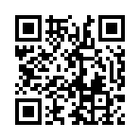


Annual General Meeting (AGM)
Tuesday 10th June – 6:00-6:20pm
Trustees report
Receiving the accounts
Receiving list of affiliations of the union, and
noting donations (if any)
  National Union of Students (Charity)
  National Union of Students (UK)
  Advice UK
Full Agenda

Slide 2
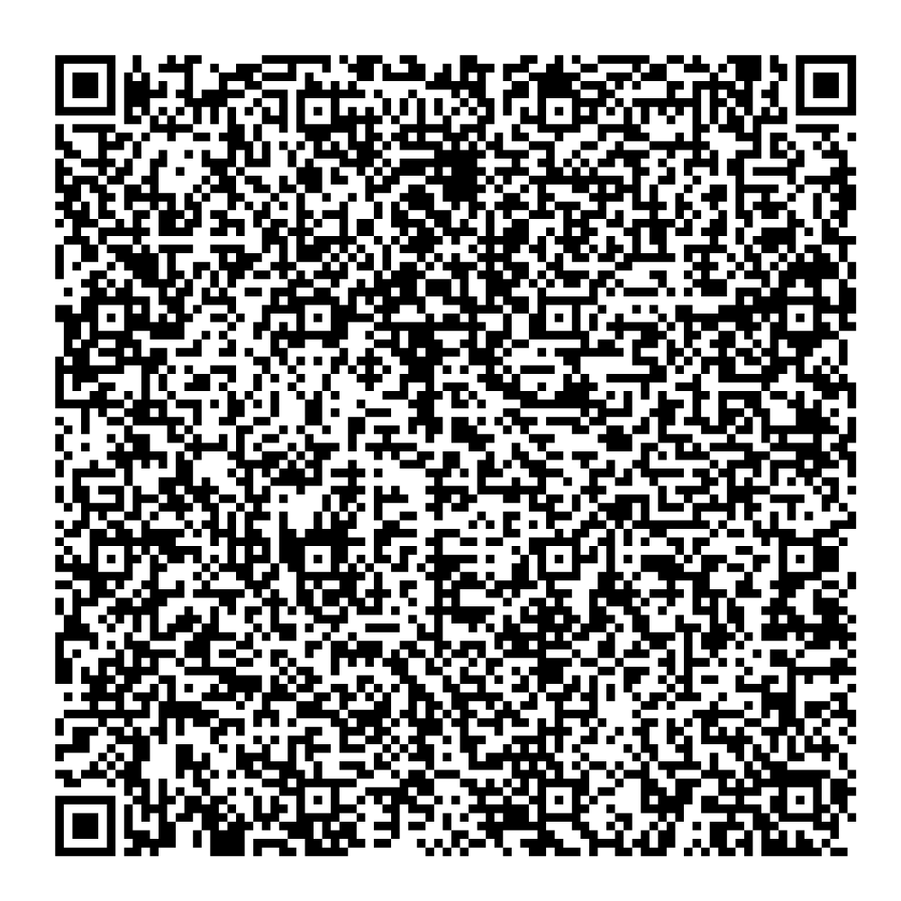
Annual General Meeting - Trustees Report & Accounts
Direct link to Charity Commission Report and Accounts

Slide 3
Following the SU Review in October 2023, decision to put the SU into a period of transformation in February 2024 to transform how we serve students
In 2023/24, six elected student officers serviced over 150 different university and college committees representing students
Consultation and delivery of the APP student submission
Ran successful elections with over 4,000 students voting
Hosted freshers' fair welcoming more than 12,000 students
Provided advice and support to 400+ students on academic, welfare and other issues
Supported various student campaigns and activities throughout the year
Staff review and restructure
Annual General Meeting - Trustees Report & Accounts
Notes:
The 2023/24 year was a time of big changes for us. After new leadership arrived in February 2024, we decided to transform how we work to better serve students. Even during this challenging period, we kept busy representing students across the University. Our six elected student officers attended over 150 committees, organised 35 events to gather student views, and ran successful elections where over 4,000 students voted. We also hosted the huge freshers fair that welcomed more than 12,000 students, provided advice and support to 400 students on everything from academic problems to welfare issues, and supported various student campaigns and activities.

Slide 4
Annual General Meeting - Trustees Report & Accounts
Following a period of organisational analysis, both current and historical, 7 key themes were established to support the transformation framework
Agreed 37 specific recommendations approved by SU Trustee Board, providing a road map for transformation
Prioritised Officer support, training and development
Committed to representing students more effectively on academic and student life matters – creating a primary purpose focused organisation
Refocus on ensuring we provide high-quality services that create impact – reviewed what we were doing and why
Focused on building better stakeholder relationships across the collegiate University to improve representative legitimacy
Notes:
Looking ahead, we've now planned out seven main goals for improving how we work, including building better relationships with the University, representing students more effectively, and making sure we provide high-quality services. With 37 specific recommendations approved by our trustees, we're setting ourselves up to be more successful in supporting Oxford students in the future. This transformation process has helped us identify what's most important and how we can do it better.

Slide 5
Financial Management During Transformation
Managed our finances carefully during the 2023/24 transformation year returning a full clean audit
Main income: £890,000 University grant
Additional income: £155,082 from commercial activities and £15,602 from welfare & other activities
Spent £1,074,664 on supporting students through advice, representation, welfare and commercial services
Separate restricted income and expenditure for Raise and Give (RAG) group held in our accounts
Financial Position and Future Stability
Achieved unrestricted surplus of £19,593 - ending year in stable financial position
Smaller surplus than previous year reflects planned transformation approach
Includes necessary changes to staffing structure during transition
Secured University funding until 2025-26 for next financial year
Provides stability needed to continue improving services for students
Annual General Meeting - Trustees Report & Accounts
Notes:
We're pleased to report that we managed our finances carefully during the 2023/24 year of transformation. Our main income came from the University grant of £890,000, plus £155,082 from our commercial activities, and £15,602 from welfare and other activities. We spent £1,074,664 on supporting students through advice and representation services, welfare support, and our commercial activities. We also had restricted income and expenditure by our Raise and Give group which is held in our accounts, but can only be spent by the union on Raise and Give activities.
This left us with an unrestricted surplus of £19,593, which means we ended the year in a stable financial position. While this surplus was smaller than last year's, it reflects our planned approach during the transformation period, including necessary changes to our staffing structure. For the next financial year we've secured University funding until 2025-26, giving us the stability we need to continue improving our services for students.

Slide 6
Annual General Meeting - Trustees Report & Accounts
Income in 23/24 - £1,134,788
University Grant - £890,000
Infrastructure Support in Kind - valued at £33,573
Commercial Activities - £155,082
Welfare and Other Income - £15,602
Raise and Give (Restricted) - £40,531
Expenditure in 23/24 - £1,117,602
Commercial Activities - £116,250
Advice and Representation - £817,685
Welfare - £140,729
Raise and Give (Restricted) - £42,938
As of the year-end, unrestricted general funds stood at £137,879, which is above the target reserves level for the Students' Union.

Slide 7
Annual General Meeting – Affiliations and Donations
NUS Charity Membership - £4168
NUS UK Membership - £16,670
Advice UK Membership - £1,200

Slide 8
Conference of Common Rooms
10/06 - 6:20 - 8:00pm
Bye-law Updates 6:20 - 6:40
Officer Year Round Up 6:40 - 6:50
Matters Arising 6:50 - 7:00
  Action Log
  Reminders (voting etc)
Motions: 7:00 - 8:00
  Motion 1 - Common Rooms Election Platform
  Motion 2 - Fee Model Consideration
  Motion 3 - Oxford Water Safety
  Motion 4 - EIRRS Position Expansion
  Motion 5 - Keep Campsfield Closed
Agenda: oxfordsu.org/ccr

Slide 9
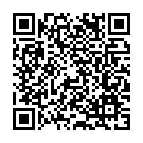
Timelines:
10/06 – Meeting takes place at 6pm
Within 48 hours of close of meeting, motions as amended (if any) opened for voting
17/06 – Voting closes at 8pm
18/06 – Results announced online & will be emailed
  Voting: oxfordsu.org/ccrvoting
  Agenda: oxfordsu.org/CCR

Slide 10
Motion Submission Process
Pre-Submission Requirements:
  Motions must have been passed by a Common Room or RepCom OR
  Proposed by a CR President & seconded by 4 others OR
  Proposed by an Officer of the SU & seconded by 2 others
Submission Requirements:
  Initial risk assessment
  Equality Impact Assessment
    Work with a RepCom to fill it in, ask for help
Board Involvement:
  Further risk assessment – may involve some amendments/conversations
  If irreconcilable, conversation will happen at CCR

Slide 11
Agenda Explained:
Conference Policy – sets a position but doesn’t ask the SU to do anything (known as a corporate position)
Conference Mandate – sets a position and asks the SU to expend resources (must be students as students)
Below the Line – It's on the agenda, you might vote on it, but it's been deemed not necessary to host a debate about it. This might include RepCom decisions or simple motions. You can request that these be brought above the line by speaking to the Chair ahead of the meeting.

Slide 12

  Agenda: oxfordSU.org/CCR

Slide 13
  Voting: oxfordsu.org/ccrvoting

